Slide 1

Hardware Hacking on a budget:
Reverse Engineering hardware tools
Conrad Franke

Slide 2
Relevant Files
-Github Repository
-Local fileserver for kicad and other documents will be provided today at presentation on hotspot named HH_TCS2023
-Demonseed
-Kicad (also available on server located on HH_TCS2023 for windows and mac. IP and file addr will be provided)

Slide 3
Agenda
1) Background and inspiration
2) Basics of electronics and components and how tools are made
3) Basics of kicad
4) Basics of reverse engineering for electronic components (use a multimeter to build out schematic, making a pcb and gbr files in kicad)
5) How to fabricate a PCB
6) Returning the product after usage and ensuring the fabbed out tool works
7) Summary

Slide 4
Background about me
-Small town in northern Michigan
-Sent to Texas military school due to poor life decisions at a young age
-Started learning more about cyber and physics in high school / challenged
-Became reverse engineer
-Started to develop my own tools and research other tools for development

Slide 5
Needed tools … much too expensive and know nothing about
-Needed hardware tools
-Price was an issue
-Knowledge of tools were of concern
-Time … who needs that?!?!
-Gained skills of EE, RE, and forward development processes in circuitry
-Can fabricate any PCB and electrical circuit I want when I need it

Slide 6
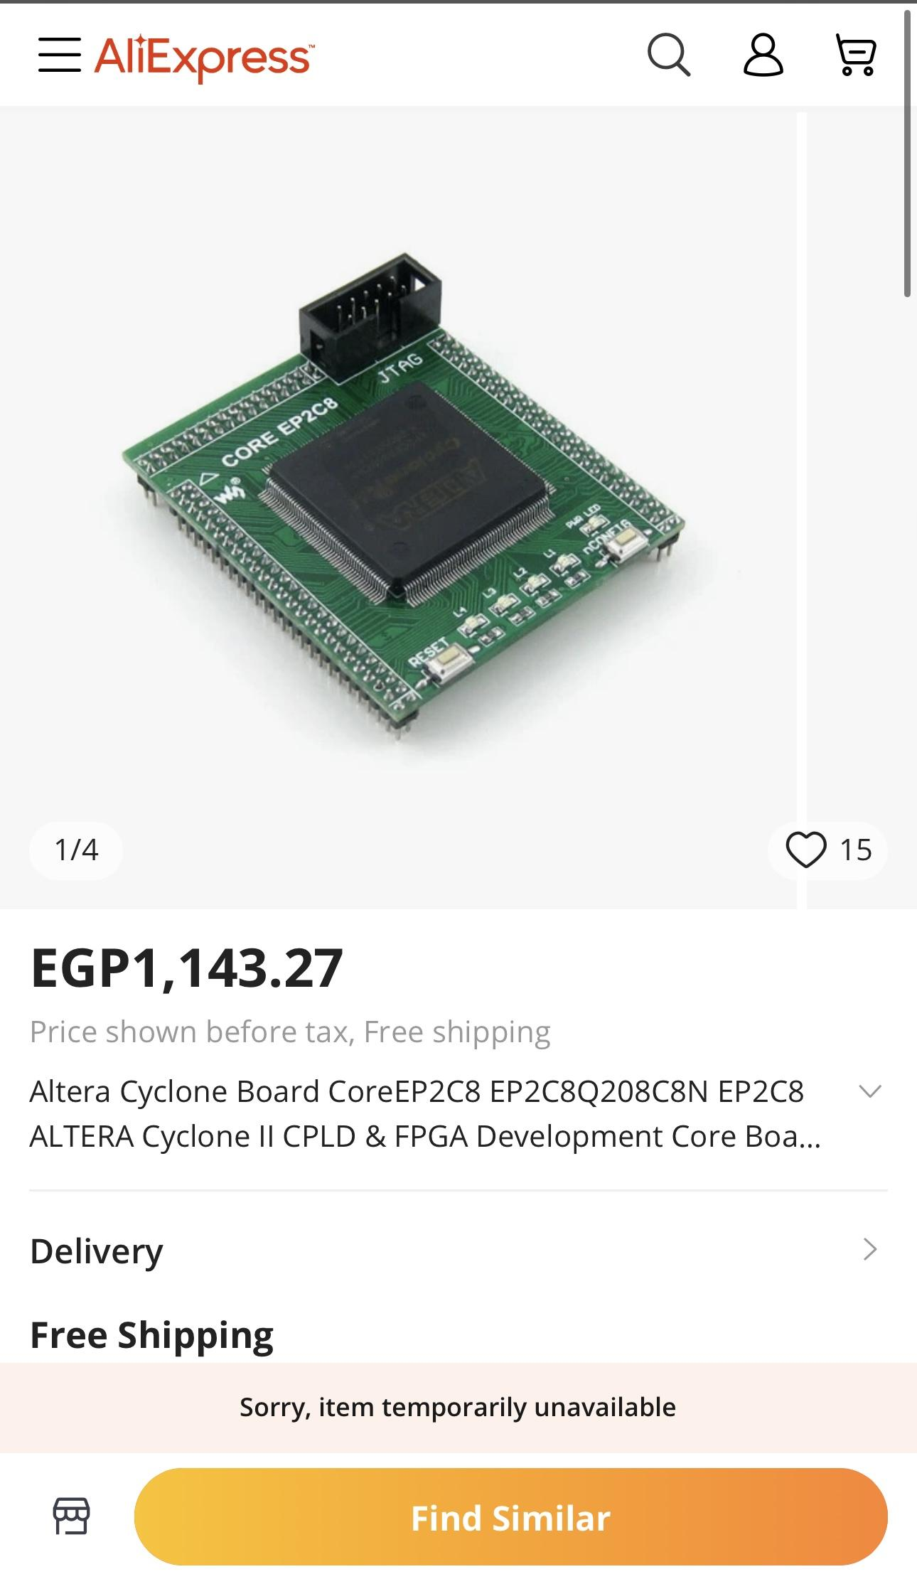
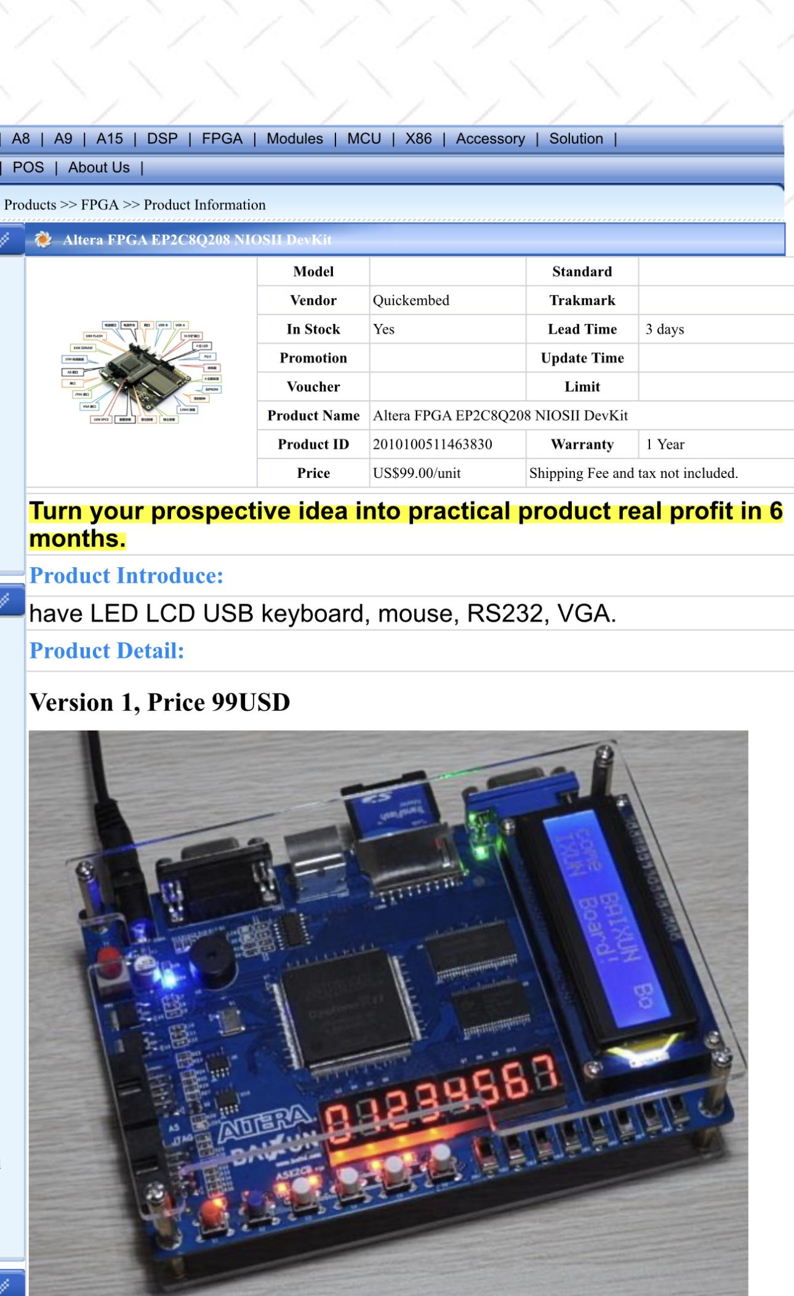
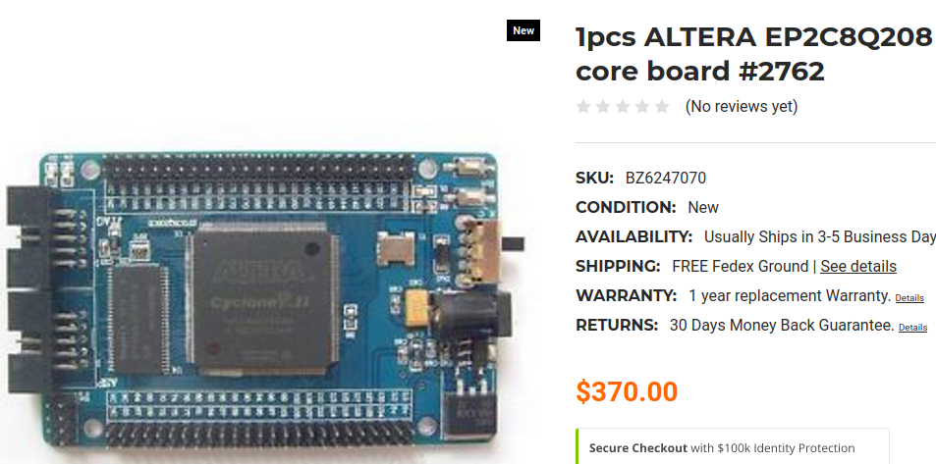
Cyclone 2 EP2C8Q208 FPGA

Slide 7
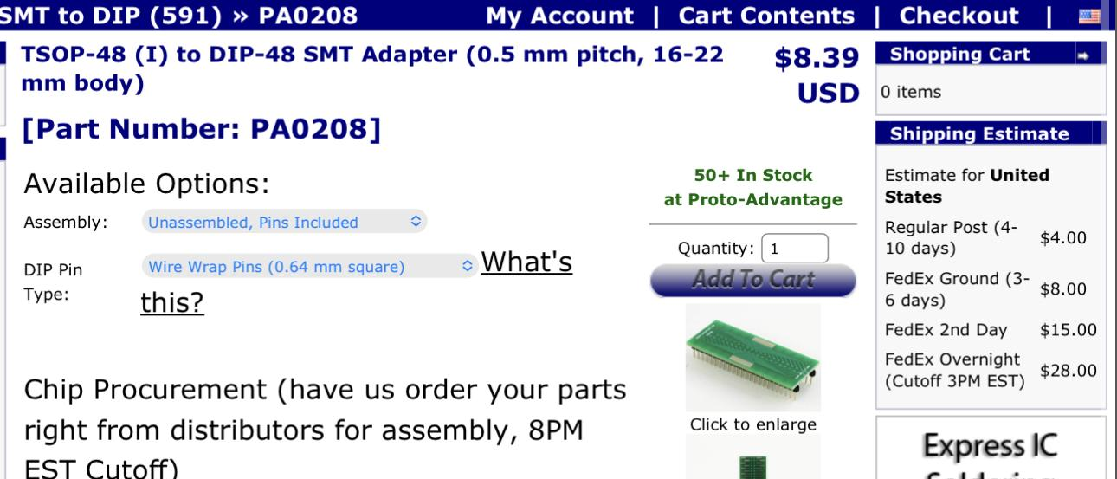
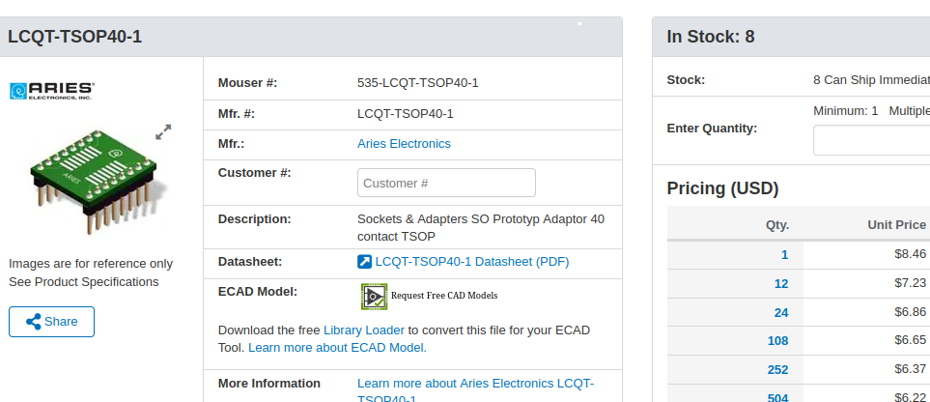
TSOP40 flash adapter

Slide 8
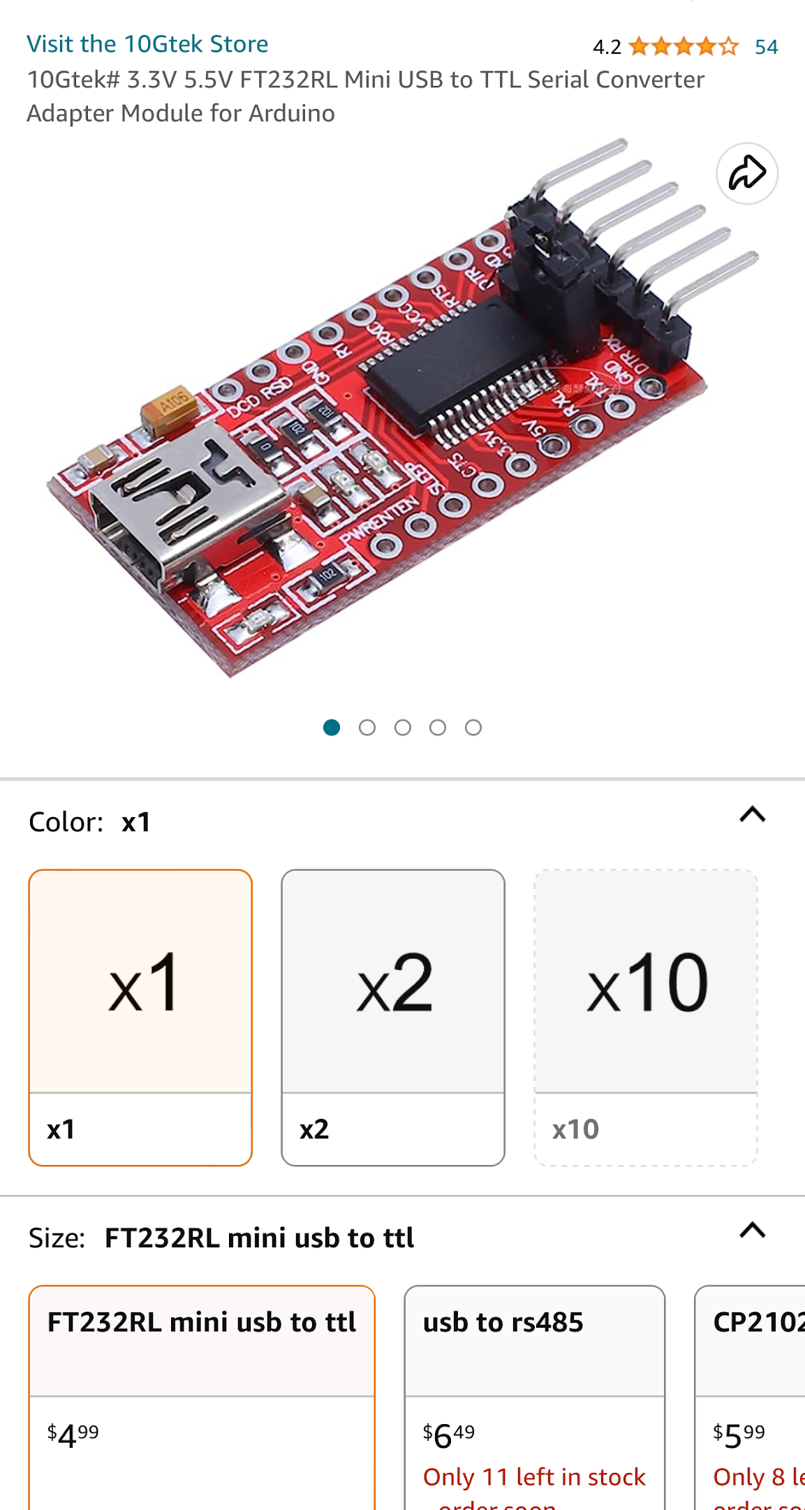
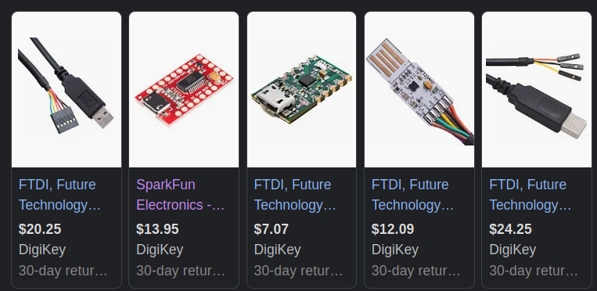
FTDI adapter

Slide 9
Sometimes Ebay or Ali express is cheaper
-Cost of time over price (takes forever)
-Tools made with low quality and sometimes will not function properly
-Engineers best judgement as to what they want. Your call to what your hardware kit should look like
-Your tools are known best by YOU! And may function better/mirror a more premium product

Slide 10
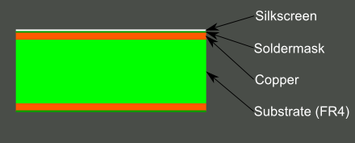
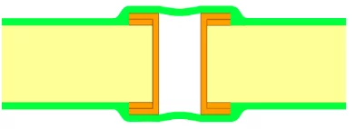
PCB…What is that? Why do I care?
-PCB stands for printed circuit board
-Most PCB’s are made up of fiberglass (FR4), copper traces to connect components, soldermask (color), and silkscreen (white lettering)
-Used to carry electrical signals to components to complete a task or function
-Can be reversed out using a continuity tester and copied
-Target HW made up of a PCB
-Need to understand components
-Multilayer boards
VIA

Slide 11
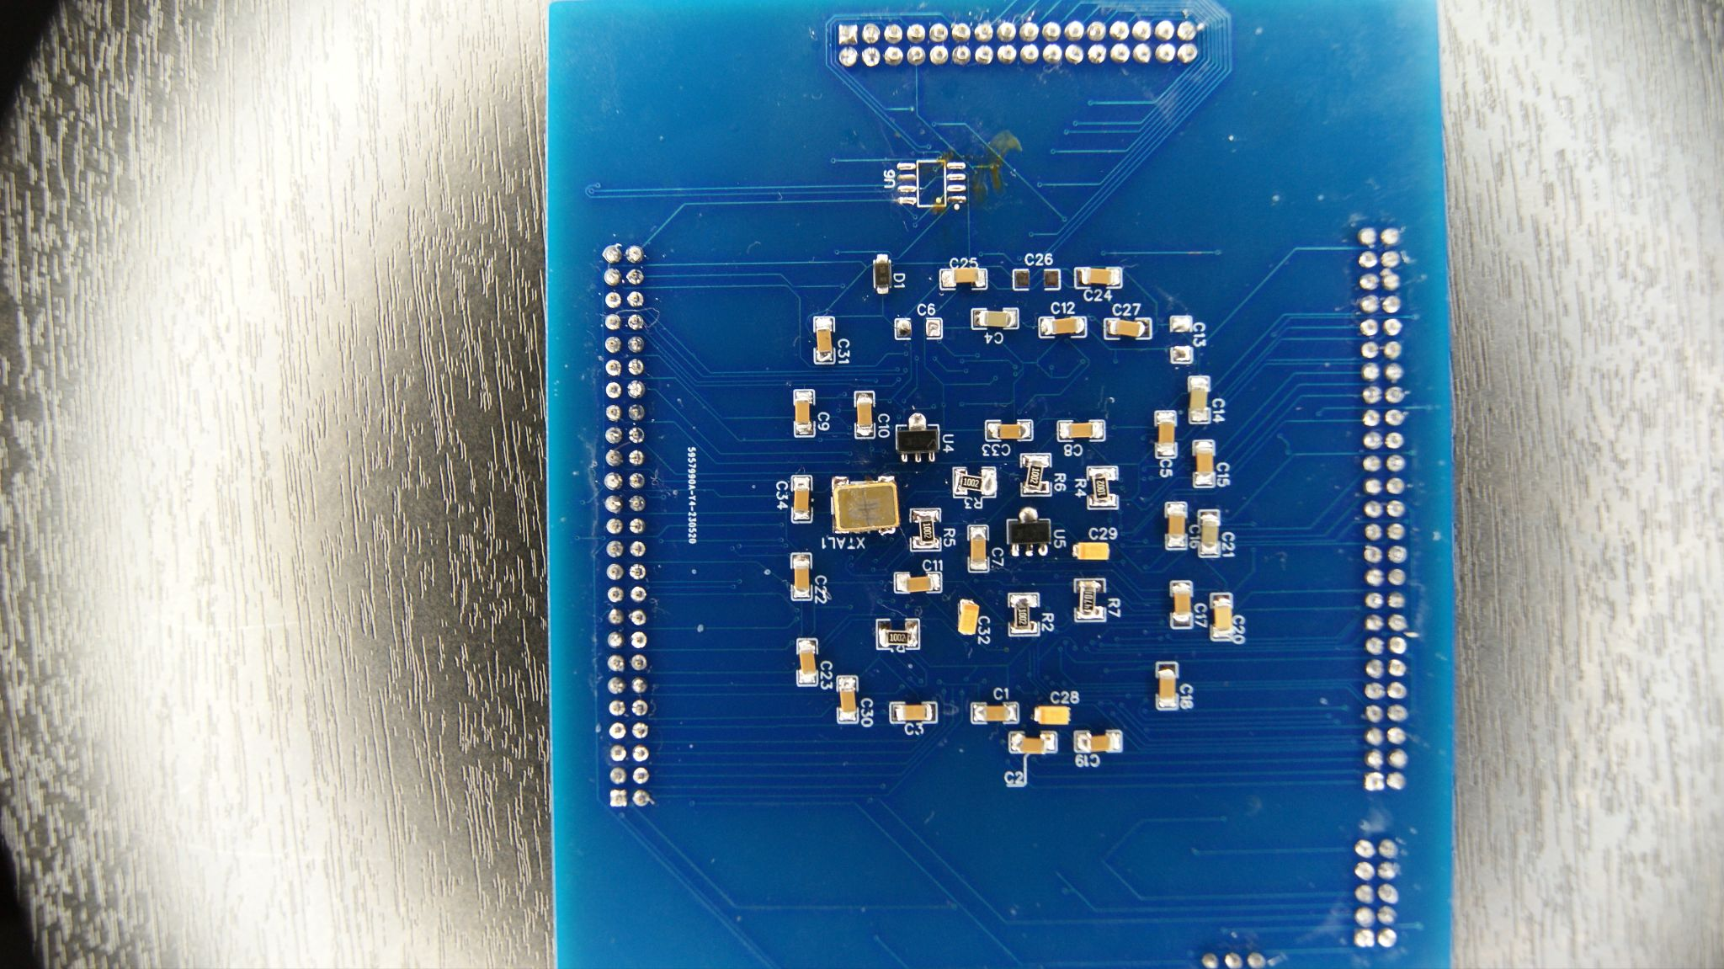
Silkscreen
Traces
VIA
SMD COMPONENTS

Slide 12
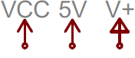

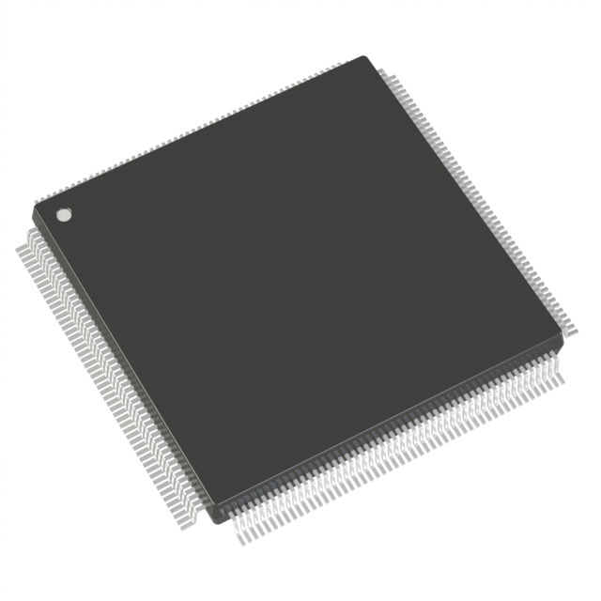
Electrical signals and power on a PCB
-Positive/Voltage (also known as VCC) IE VCC5
-Negative/Ground (also known as vss) IE GND or VSS
-Signals (protocols, data) IE spi, i2c, can, jtag, uart (not noted at all)
-G eneral P urpose I nput O utput signals (can be configured; not noted except for pins)
-Refer to datasheets for proper electrical signals
-Circuits use these signals to be effective (like hw tools)

Slide 13
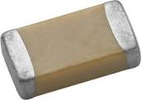
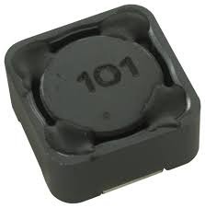
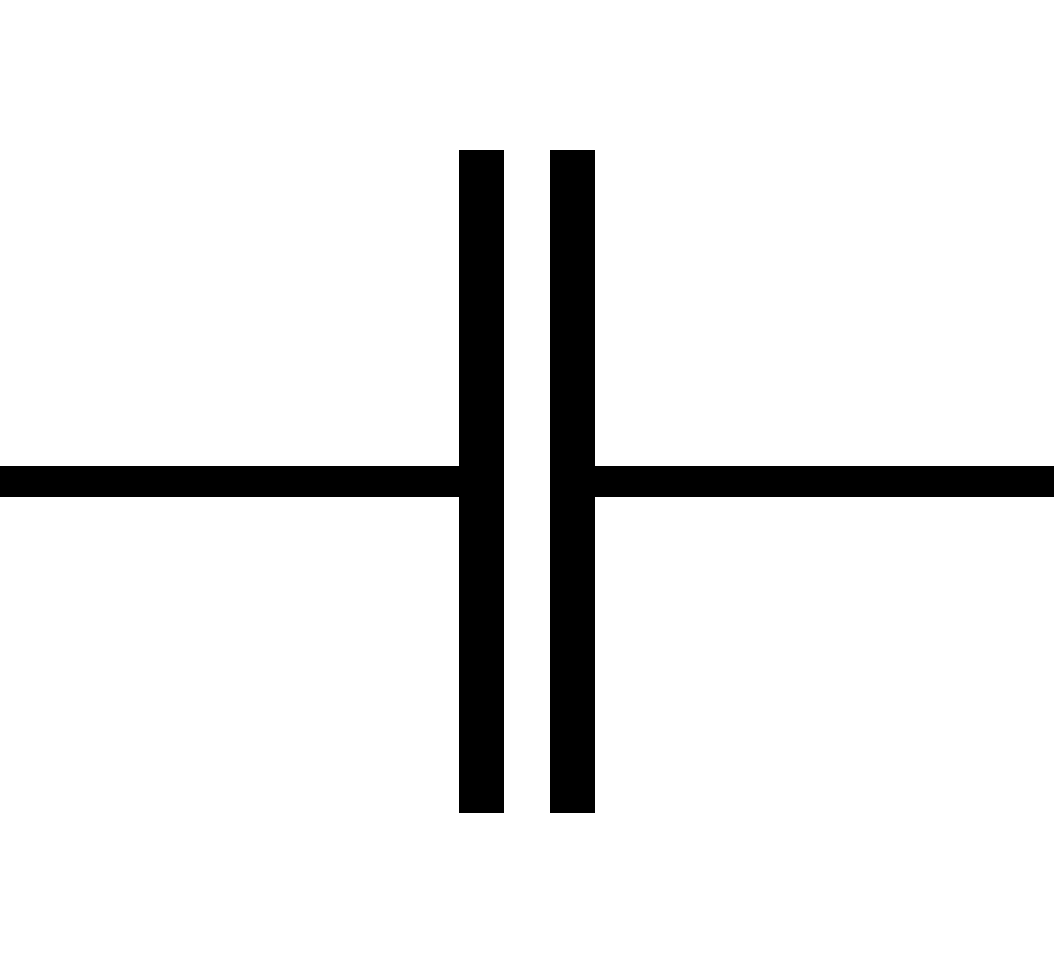
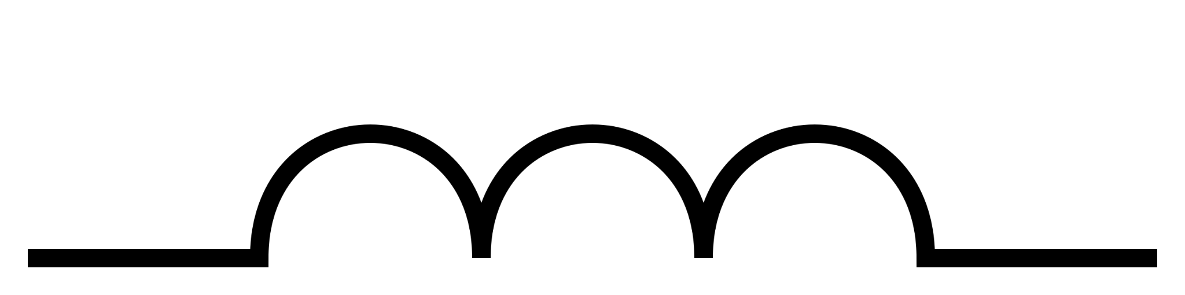
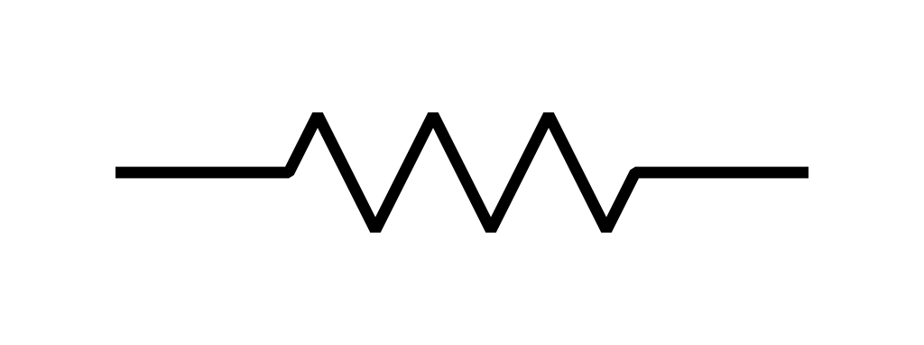
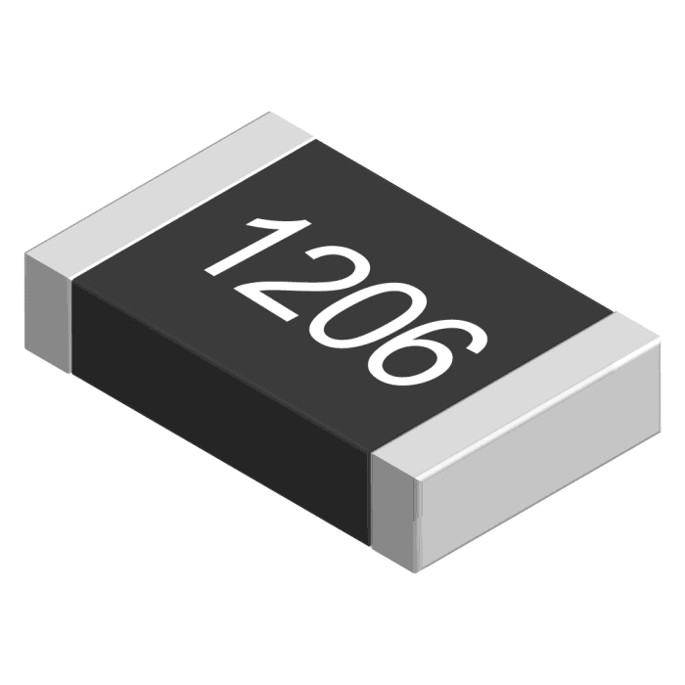
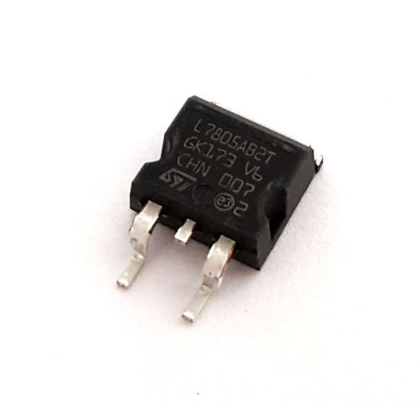
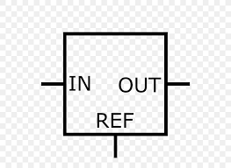
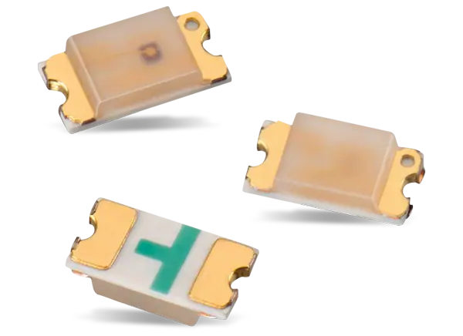
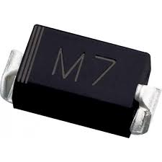
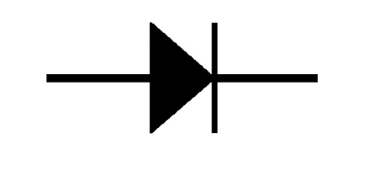
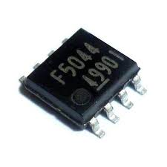
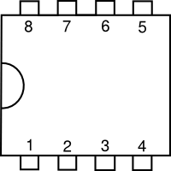
Electronics on a PCB Cont. (components - sometimes free)
Capacitor (and inductor) | Stores energy for safe power down Reduces noise Etc | Cap. Inductor | Cap. Inductor | Cap - C Inductor - L | cap-Farad Inductor- Henry
Resistor | Reduces Voltage/current in circuit |  |  | Resistor - R | Ohm
Regulator | controls voltage in circuit |  |  | Regulator - U | Volts
Diode/LED | Forces flow of power to move in one direction |  |  | Diode - D | power
IC/Clock/ETC… | Other electrical components |  |  | IC - U Other - Y/Q/X…etc | N/A

Slide 14
Electronics Cont. (Datasheets)
-Every electronic part more than likely has one (except proprietary)
-Tells you package information and ratings IE 1206 size and 3.3v at 200mah
-Can be found on website ordering from
-Use this as a reference to almost every electrical component you buy/place onto a tool
-Aquiring the wrong part without consulting the datasheet may cause shorts or electrical issues in the circuit. In fact it more than likely will.

Slide 15
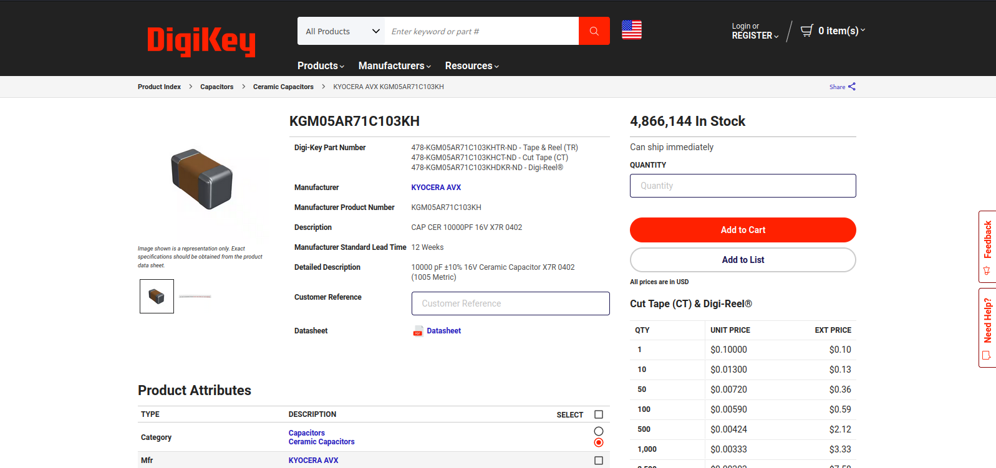

Slide 16
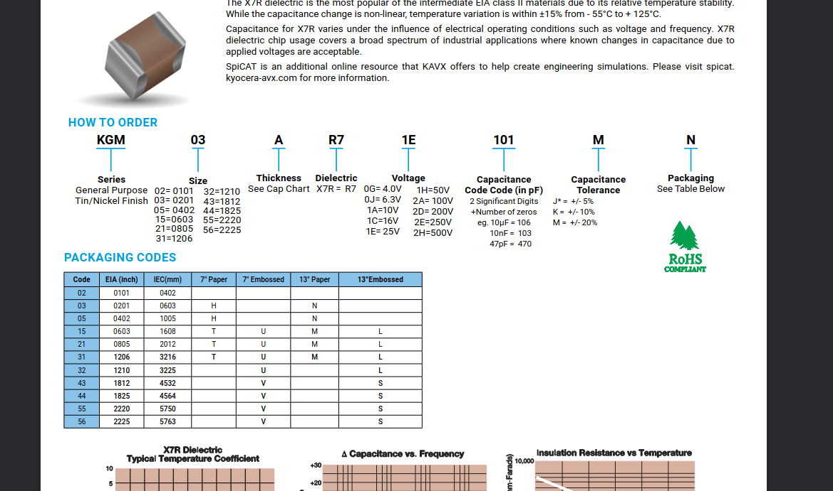

Slide 17
Electronics cont. (Schematic)
-Schematics are used to describe an electrical circuit to carry electricity and signals to the proper components and ultimately to ground
-Helps build out the printed circuit board
-Can also be reverse engineered easily
-Provide a good template to build more projects off of/add to for future tools
-Contain some description of components needed to build the circuit in question

Slide 18
Chip off method process
-Buy tool
-Switch out component that you need (find on old computer or buy something significantly cheaper that “looks the same”)
-Return or sell on ebay “for parts”
-Usually account gets locked if returned or asked for replacement if found tampering
-Can become more costly and complicated
-Time efficient vs dumping firmware or ordering parts from overseas
-disclaimer. I told you not to do this!

Slide 19
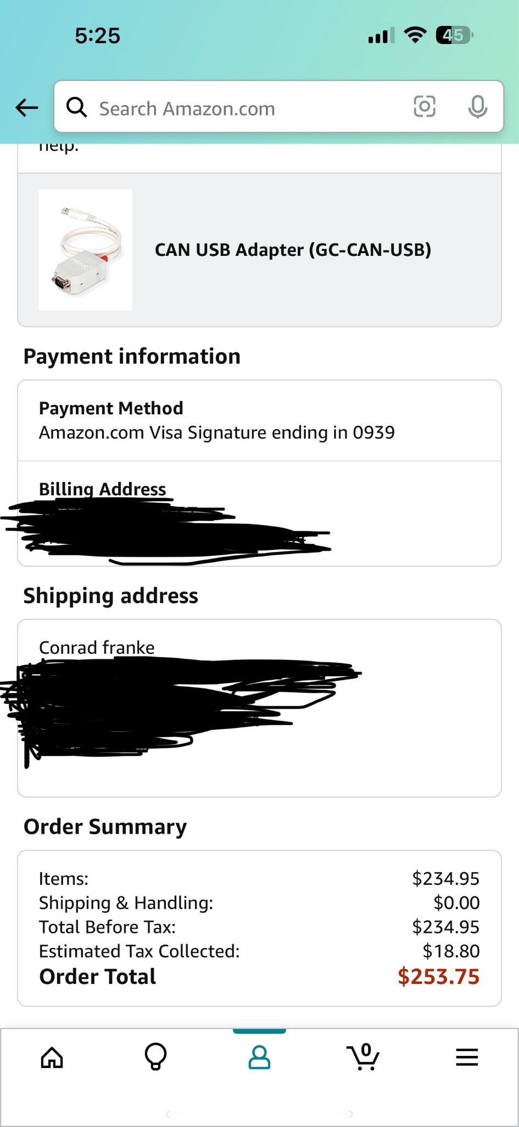
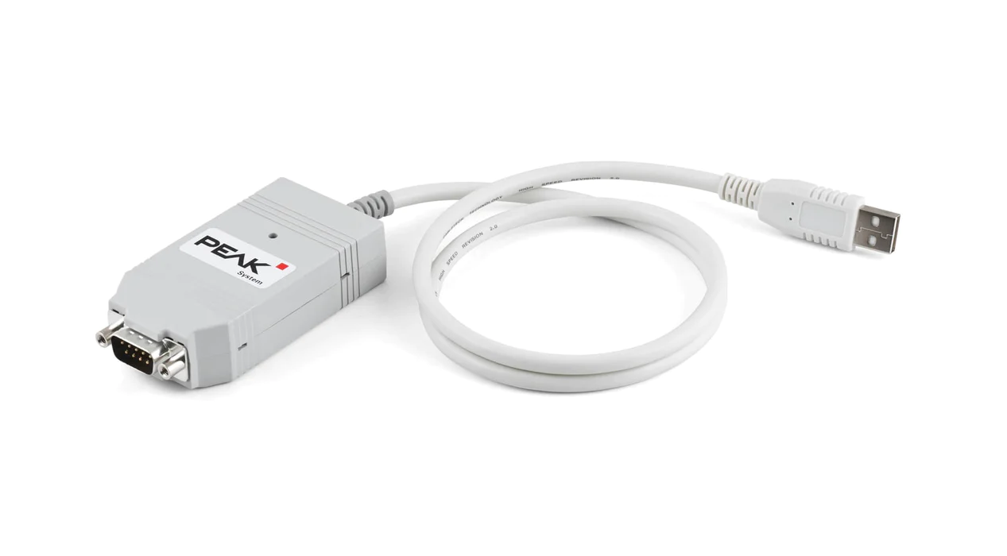
PEAK-CAN can bus analyzer (automotive tool)

Slide 20
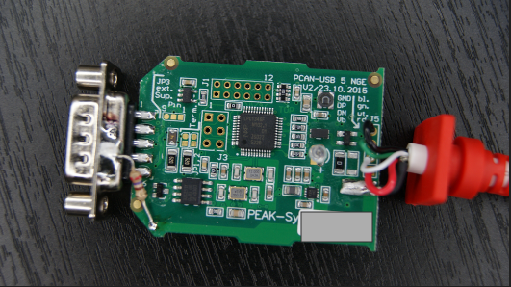
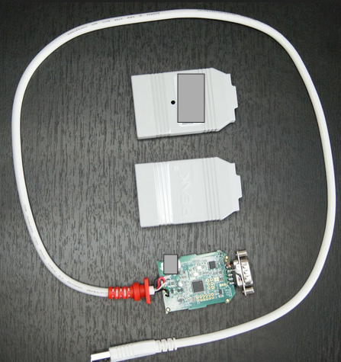
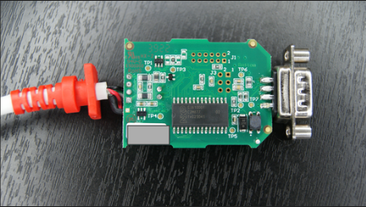
PEAK CAN Images

Slide 21
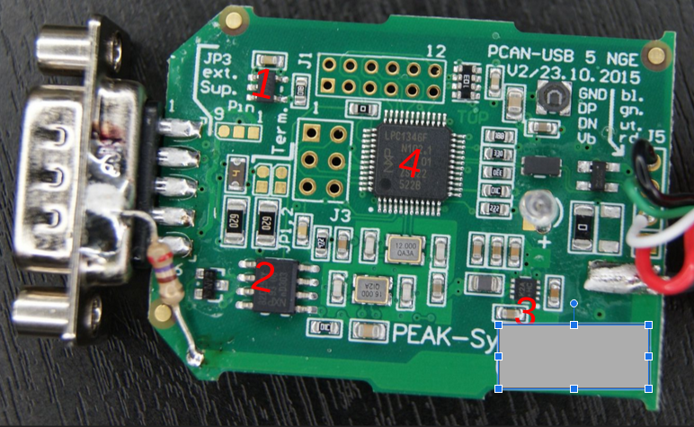
Components (front)
1
4
2
3
-Components were found online using tools
-EX https://smd.yooneed.one/

Slide 22
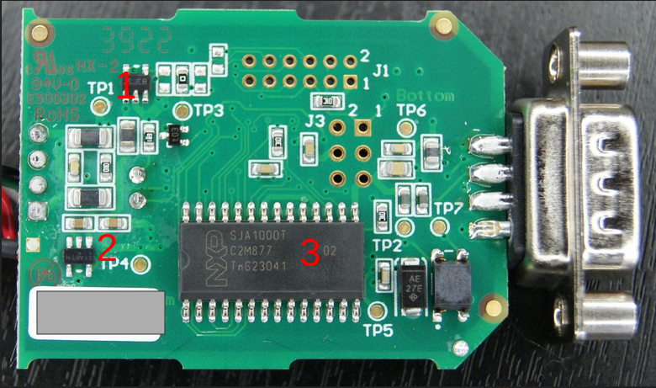
Components (back)

Slide 23
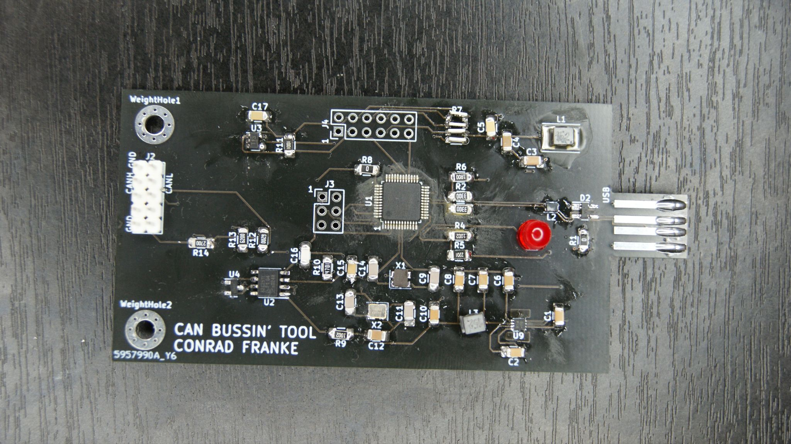
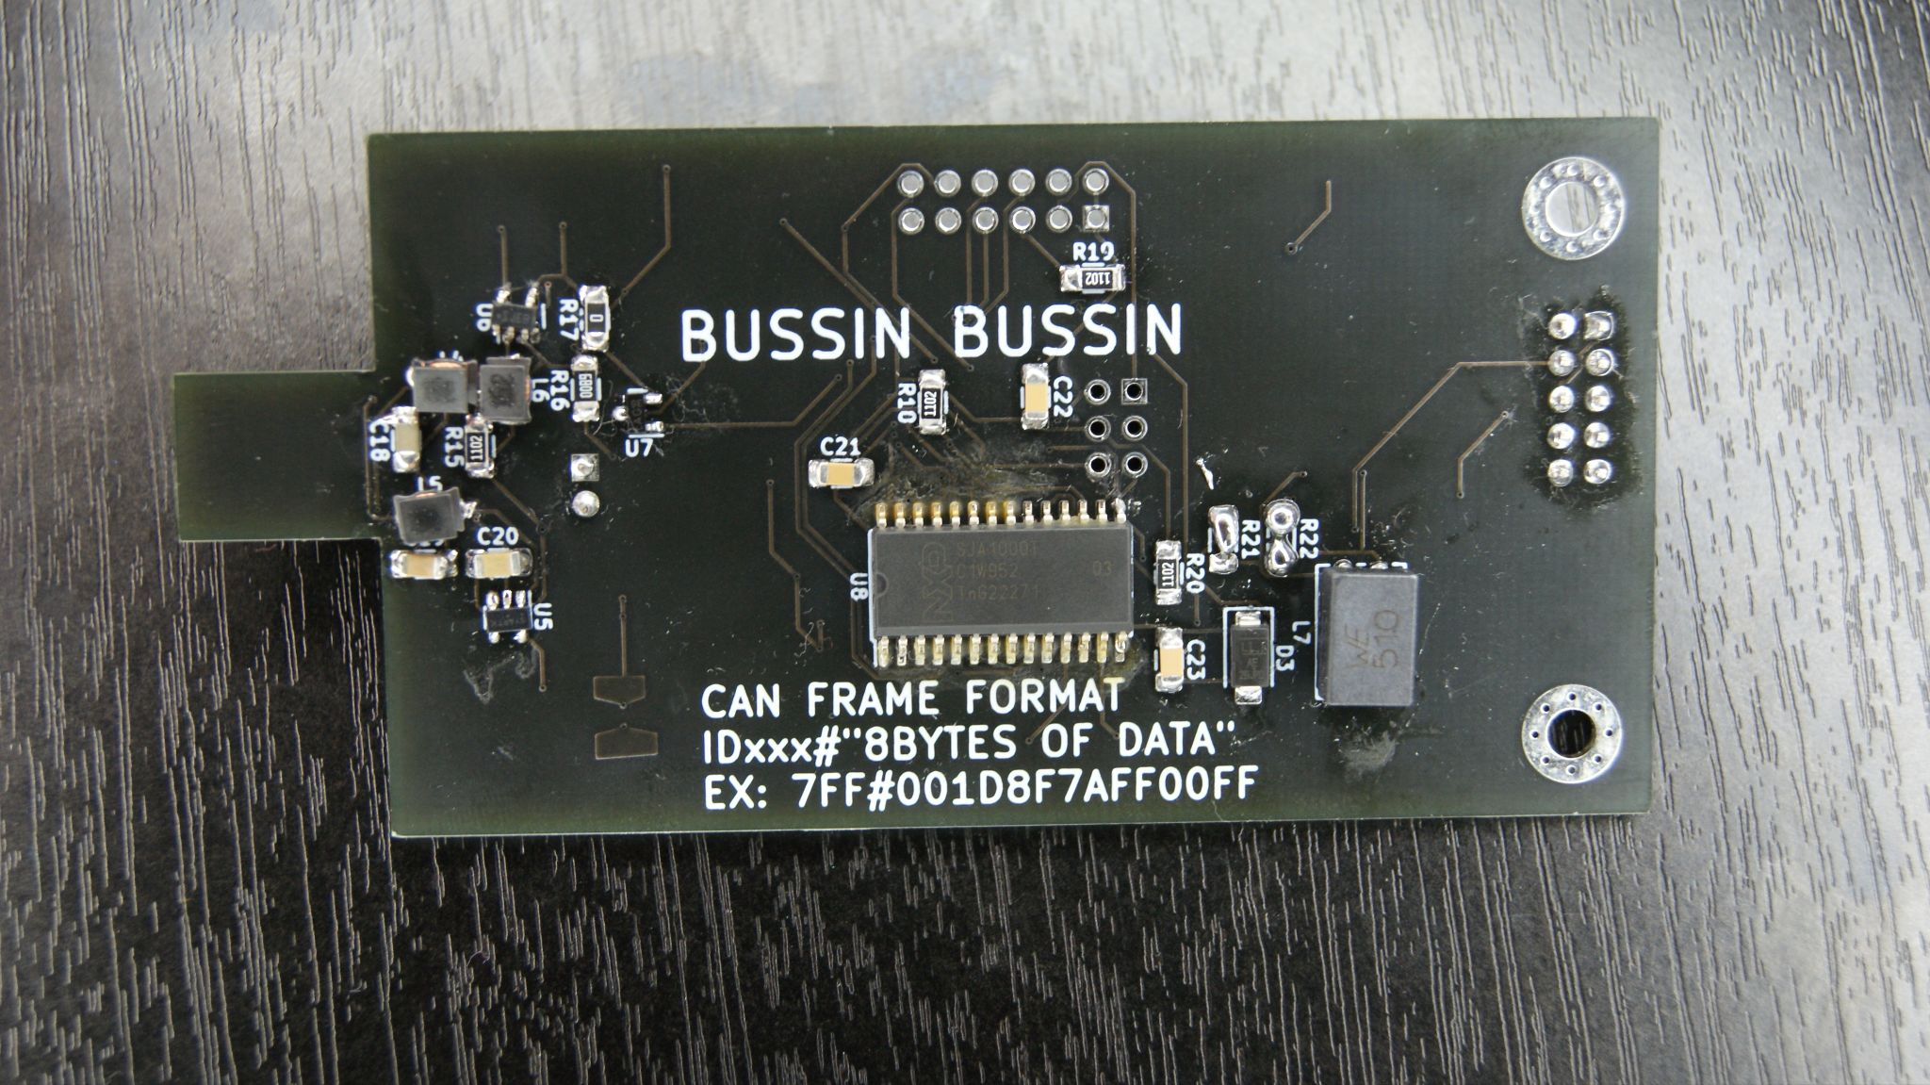
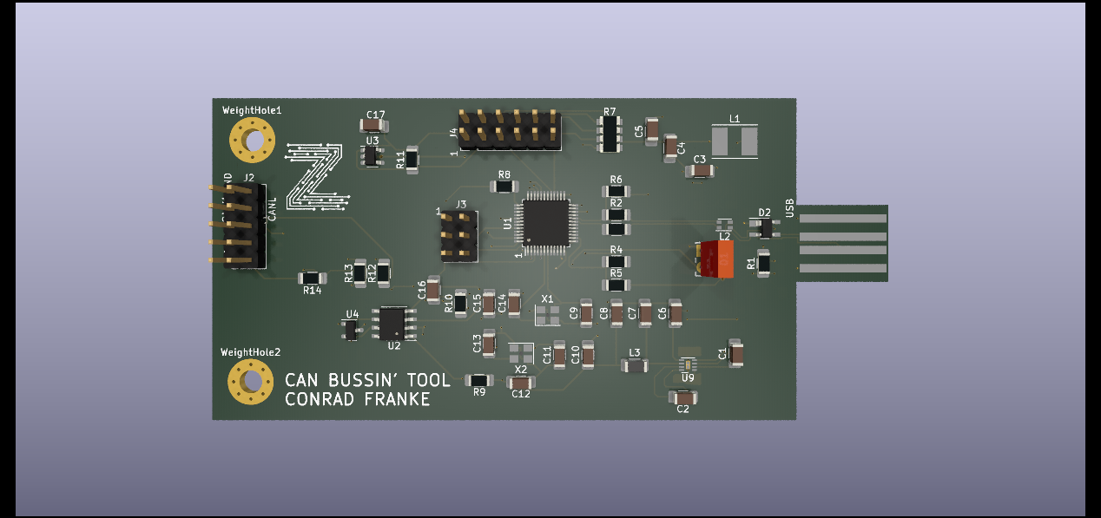
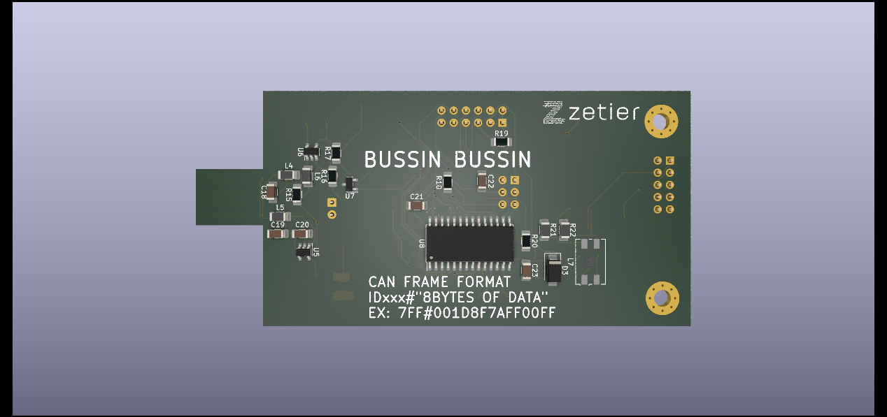
Copycats
-Took 2 weeks of freetime and extra time
-Blew a voltage regulator/replaced it
-Circuit finished
-Cost total was about 50$ in total.
-Firmware acquisition hardest part … if that path is chosen

Slide 24

For example, YOU need this tool!

Slide 25

Kicad
-Schematic and PCB design tool
-Used to make FTDI boards from Zetier
-Used by hardware and electronic engineers to design tools and real world components
- Kicad has been used to design and fab boat controls, autonomous vehicles, radio frequency components, IOT devices and everything in between
-Lots of documentation and youtube videos
-Free

Slide 26
Kicad/FAB RE on DemonSeed

Slide 27


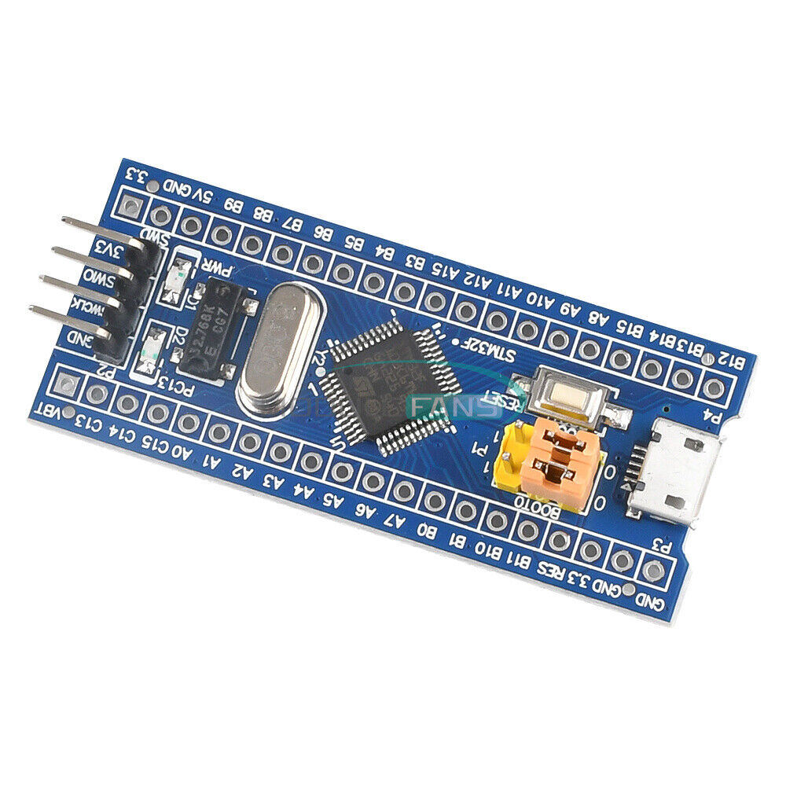
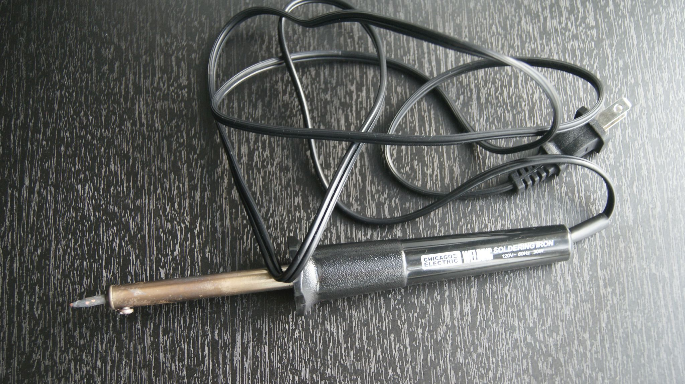
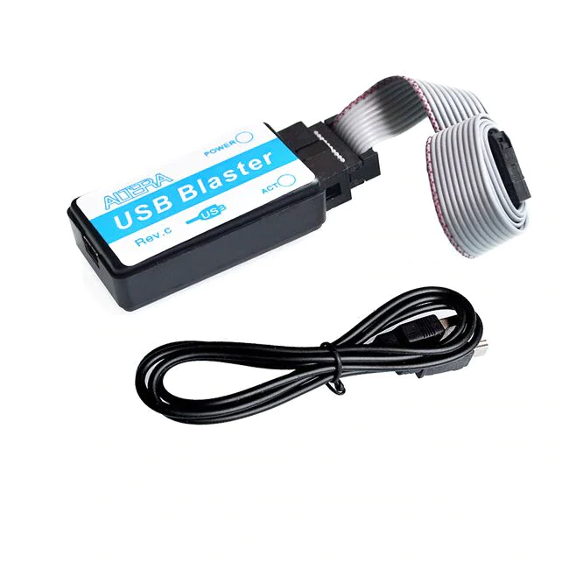
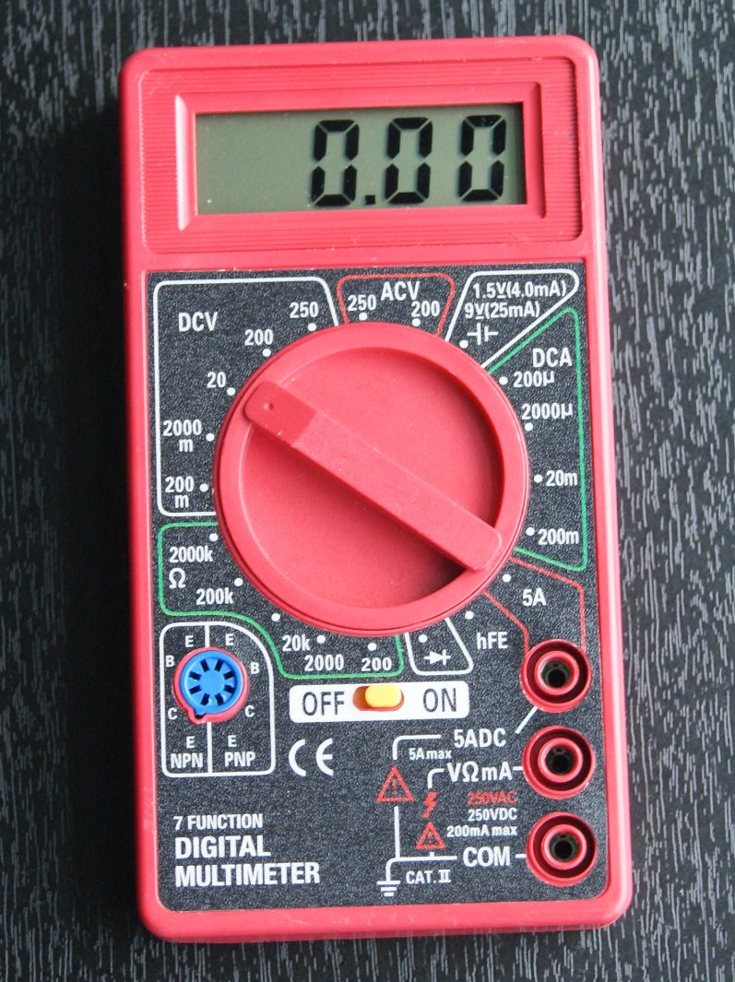
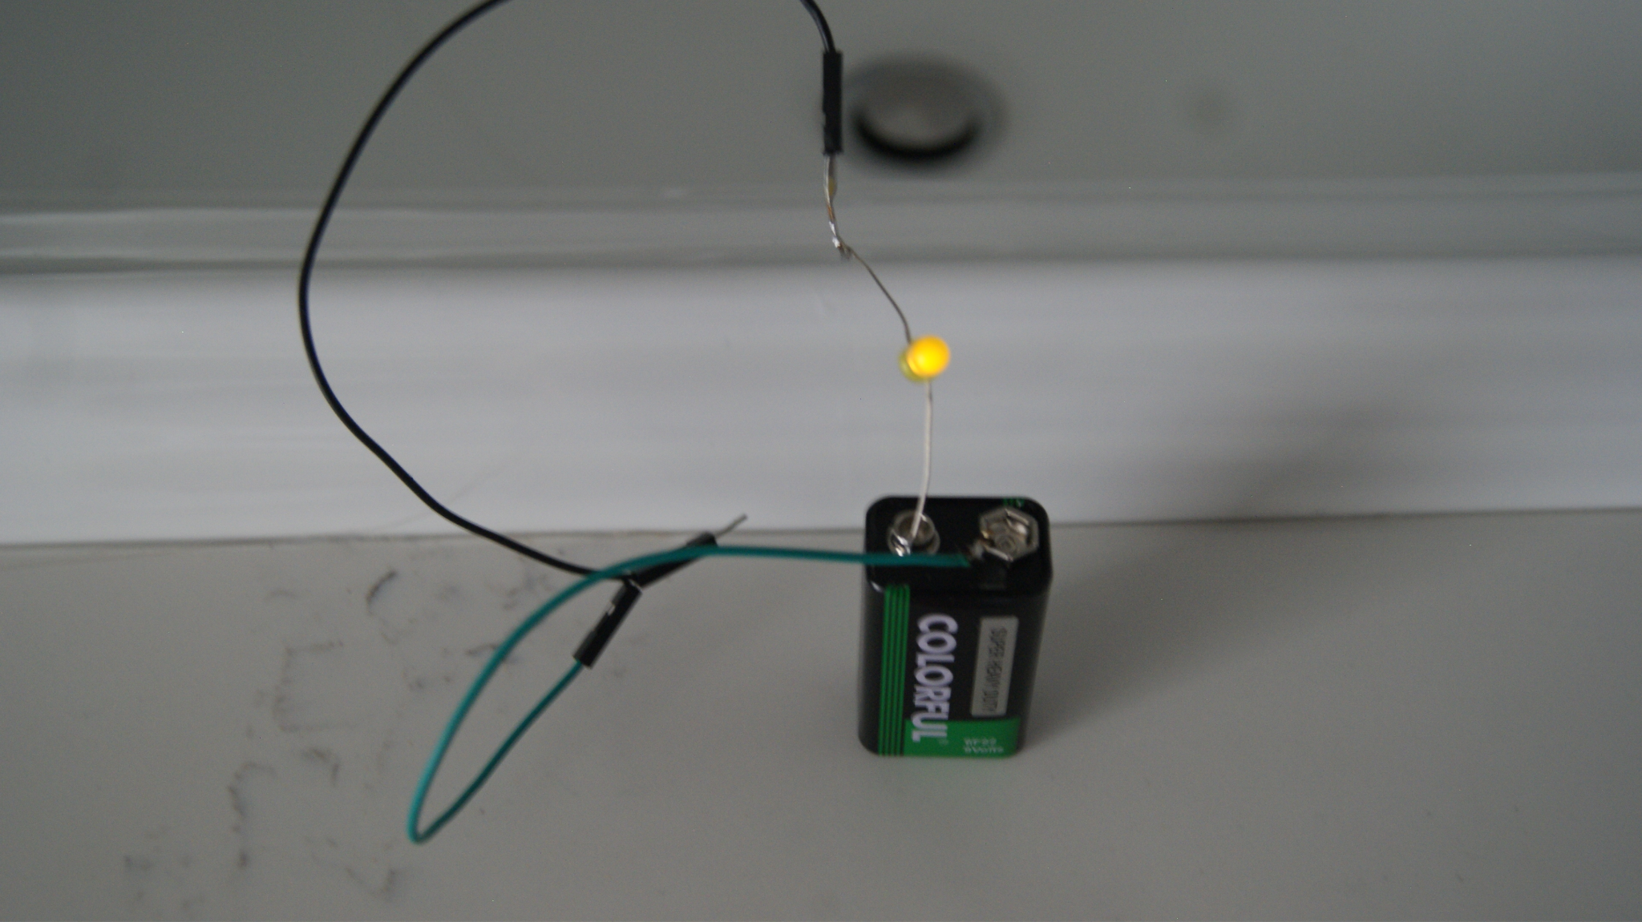
Some reverse Engineering Tools
STM32F103C8
reversible/public schematic
https://embo.jakubparez.com/
Firmware extraction: http://urjtag.org/
$5⁴⁹
$6⁹⁹
Homemade Continuity tester $Free
Reversible/public schematic

Slide 28
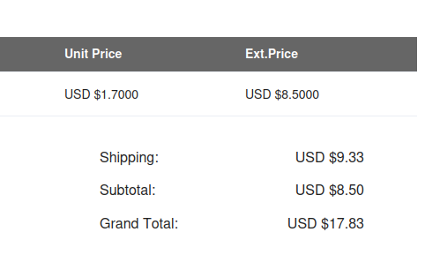
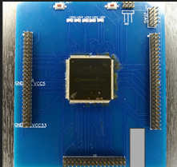
Devkit board for Cyclone 2 EP2C8Q208 FPGA
~$19 per board
-This was made with only a schematic
-No hardware was available at the time for a reasonable cost with time allotted

Slide 29

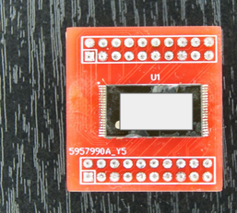
TSOP40 flash adapter
-$0.88 Per board
-Made with Kicad footprints and images of adapters available on the internet

Slide 30
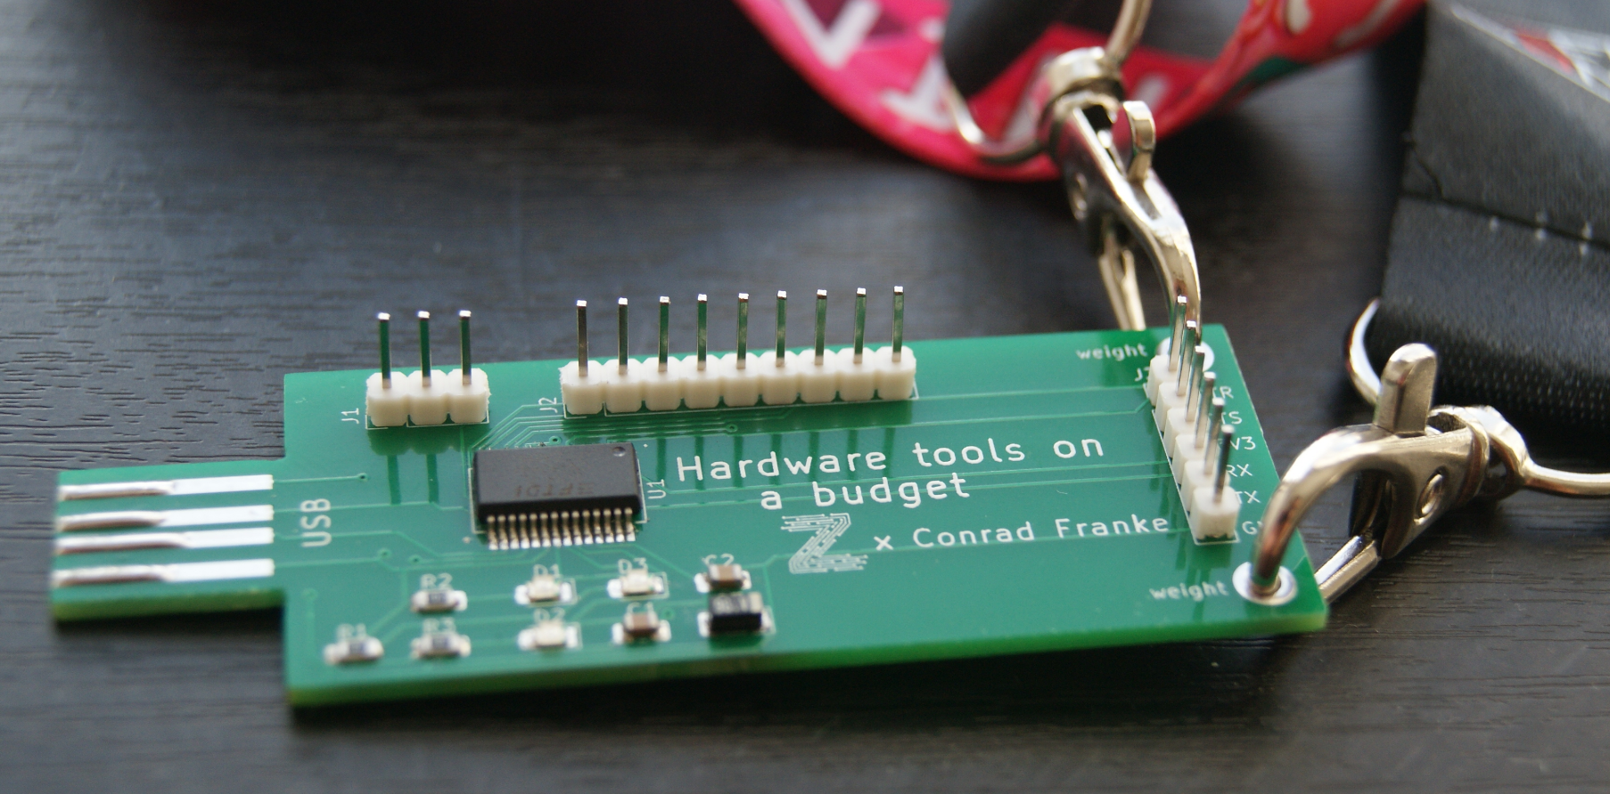
Your turn
-FTDI adapters
-Study schematic and parts / practice building your own. Don't worry about breaking it as you can order new ones using the gerbers for cents and in a pack
-Beat some of the prices you find. For an item cloned this much and available on aliexpress, it is hard to beat some prices but not impossible. Try using old components that you may have laying around in the house or in old electronics.
-include shipping with other components to save
Bom files and instructions available at:

Slide 31
Questions?

